Slide 1

MCMC I for Infectious Diseases Gerardo Chowell, PhD Professor of Epidemiology and Biostatistics SISMID 2024

Slide 2
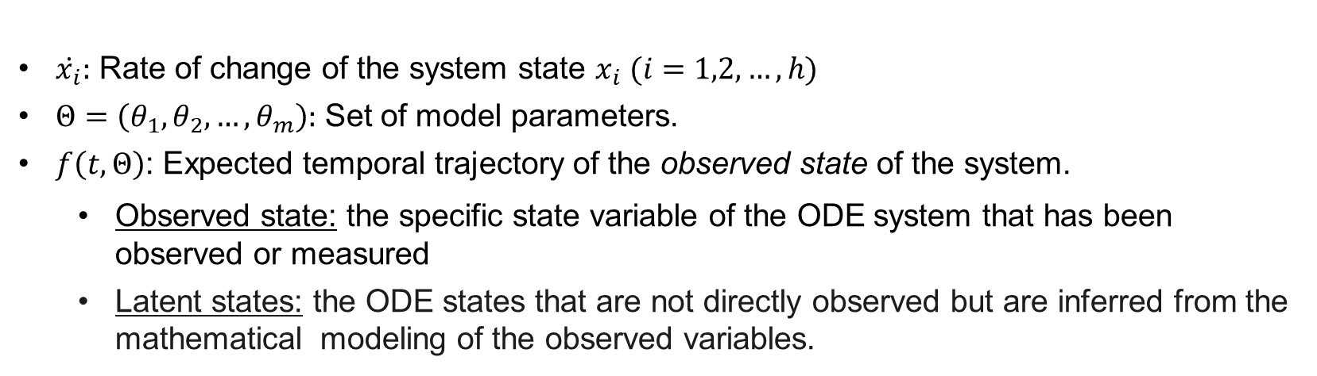
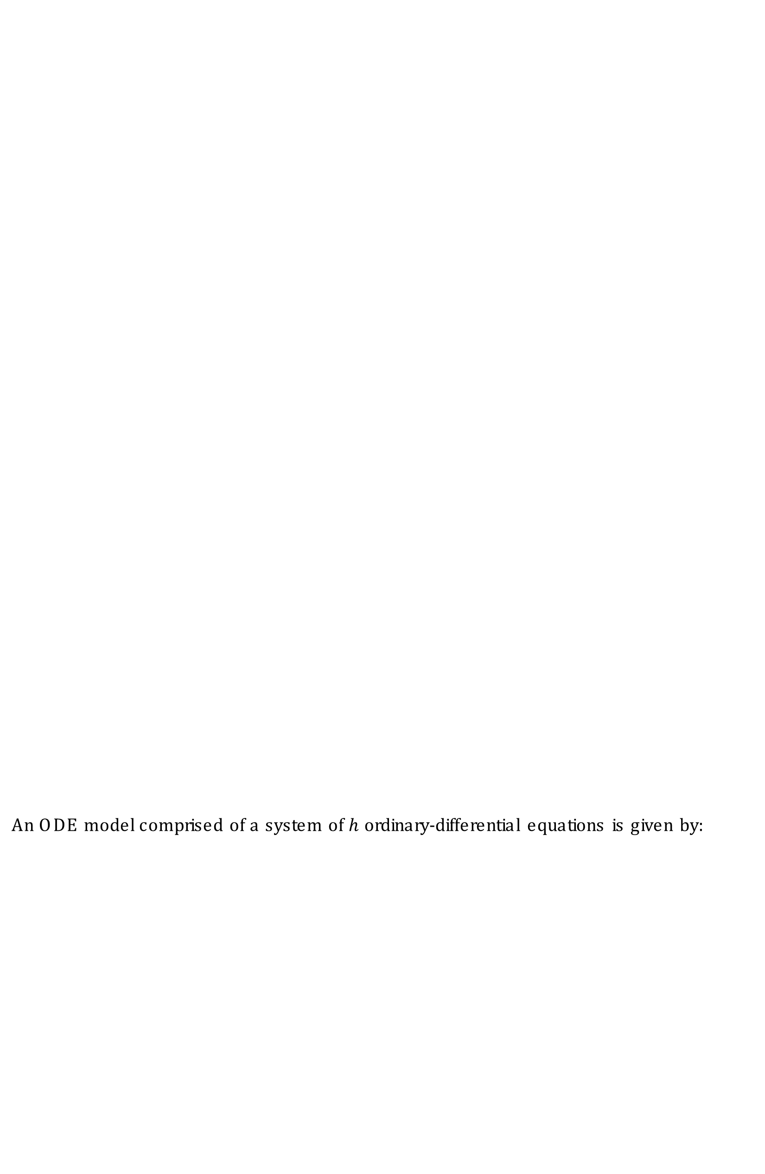
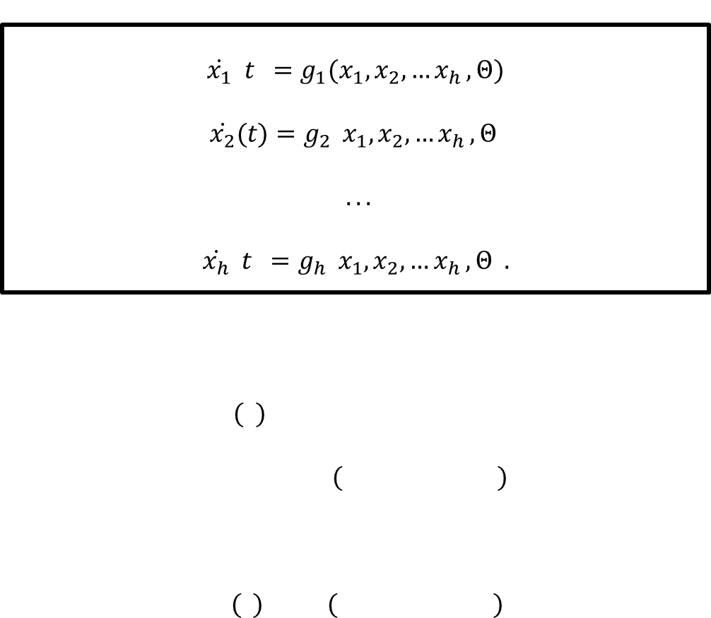
Compartmental ODE model
An ODE model comprised of a system of $h$ ordinary-differential equations is given by:
$$\dot{x_{1}}\left(t\right)=g_{1}(x_{1},x_{2},{…x}_{h},Θ)$$
$$\dot{x_{2}}(t)=g_{2}\left(x_{1},x_{2},{…x}_{h},Θ\right)$$
$...$
$$\dot{x_{h}}\left(t\right)=g_{h}\left(x_{1},x_{2},{…x}_{h},Θ\right).$$
$\dot{x_{i}}:$ Rate of change of the system state $x_{i} (i=1,2,…,h)$
$Θ=\left(θ_{1},θ_{2},…,θ_{m}\right):$ Set of model parameters.
$f\left(t,Θ\right)$: Expected temporal trajectory of the observed state of the system.
Observed state: the specific state variable of the ODE system that has been observed or measured
Latent states: the ODE states that are not directly observed but are inferred from the mathematical modeling of the observed variables.

Slide 3
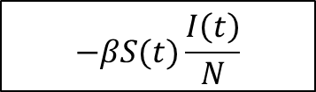
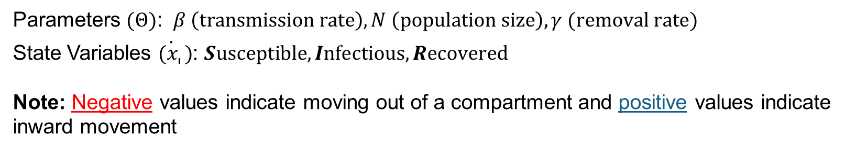

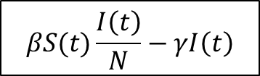
Example: SIR Model
$$−βS(t)\frac{I\left(t\right)}{N}$$
$$βS(t)\frac{I\left(t\right)}{N}−γI\left(t\right)$$
$$γI\left(t\right)$$
Parameters $(Θ)$: $β \left(transmission rate\right), N \left(population size\right), γ (removal rate)$
State Variables $\dot{{(x}_{i}})$: $Susceptible, Infectious,Recovered$
Note: Negative values indicate moving out of a compartment and positive values indicate inward movement

Slide 4
Model Calibration: Observed time series data
Assuming that there is a single observed state (i.e., recorded infections) let $y_{t_{1}, }y_{t_{2}},…,y_{t_{n}}$denote the time series of the observed state of the system used to calibrate the model.
Here, $t_{j}$, $j=1,2,…,n$, are the time points for the time series data (i.e., dates), and $n$ is the number of time points (etc., 29 in the above figure).

Slide 5
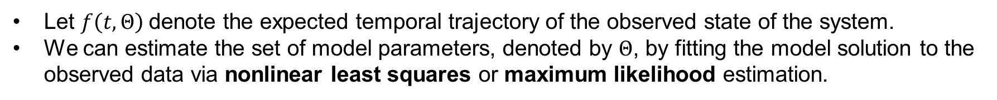
Parameter Inference
Let $f\left(t,Θ\right)$denote the expected temporal trajectory of the observed state of the system.
We can estimate the set of model parameters, denoted by $Θ$, by fitting the model solution to the observed data via nonlinear least squares or maximum likelihood estimation.
This is the model calibration step that consists of searching for a match between observed and simulated model solutions via statistical inference.
Adapted From Chowell et al. Infectious Disease Modeling. 2017

Slide 6
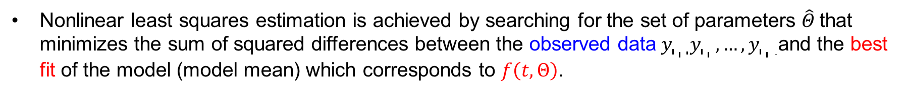
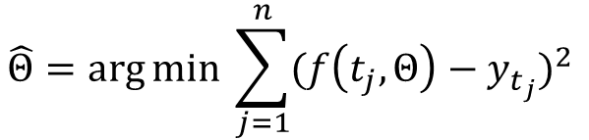
Nonlinear least squares fitting (NLSQ)
Nonlinear least squares estimation is achieved by searching for the set of parameters $\hat{Θ}$that minimizes the sum of squared differences between the observed data$y_{t_{1}, }y_{t_{2}},…,y_{t_{n} }$and the best fit of the model (model mean) which corresponds to $f\left(t,Θ\right)$.
$$\hat{Θ}=\arg{\min{ \sum_{j=1}^{n}{{(f\left(t_{j},Θ\right)−y_{t_{j}})}^{2}}} }$$
When to NOT use NLSQ: Errors have non-constant variance (heteroscedasticity); it can lead to inefficiency in the NLS estimates.

Slide 7
Solution: Maximum Likelihood Estimation (MLE)
Estimate parameters assuming a specific error structures in the data.
Poisson
Negative Binomial (Overdispersion)

Slide 8
Parametric bootstrapping to quantify uncertainty

Slide 10
Bootstrapping: Quantifying Parameter Estimation
Model parameters and their confidence intervals are estimated by fitting the model to the aggregated incidence curve.

Slide 11
Bootstrapping: Uncertainty of the model best fit
95% prediction intervals of model fits are obtained using parametric bootstrapping.
Adapted From Chowell et al. Infectious Disease Modeling. 2017

Slide 12
Bootstrap realizations

Slide 13
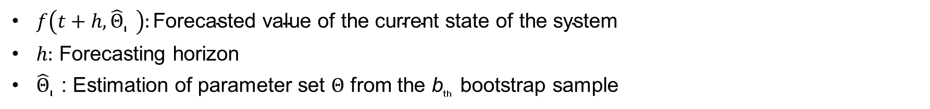
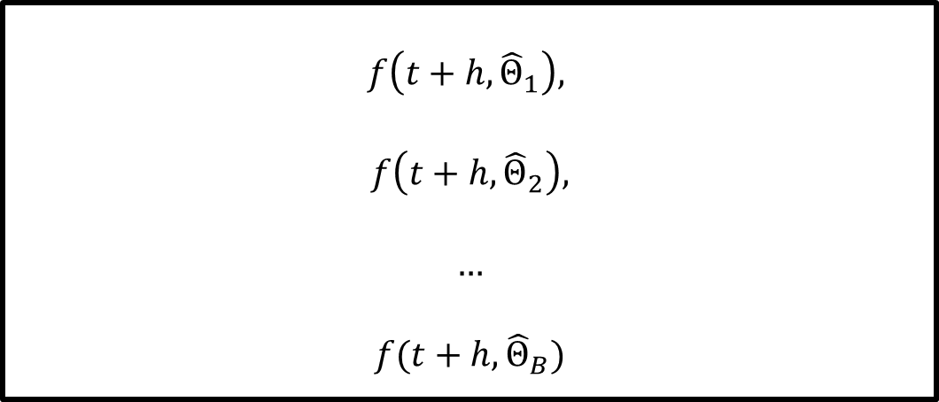
Model-based forecasts with quantified uncertainty
Based on the best-fit model $f\left(t,\hat{Θ}\right),$we can make $h$ ahead forecasts using the estimate$f\left(t+h,\hat{Θ}\right):$
$$f\left(t+h,{\hat{Θ}}_{1}\right),$$
$$f\left(t+h,{\hat{Θ}}_{2}\right),$$
$$…$$
$$f(t+h,{\hat{Θ}}_{B})$$
$f\left(t+h,{\hat{Θ}}_{B}\right):\text{F}\text{orecasted} \text{value} \text{of} \text{the} \text{current} \text{state} \text{of} \text{the} \text{system}$
$h:$ Forecasting horizon
${\hat{Θ}}_{B}$: Estimation of parameter set $Θ$ from the b_{th} bootstrap sample

Slide 14
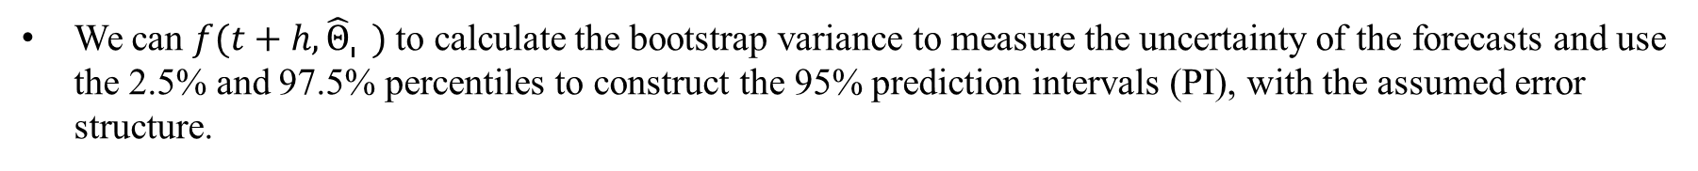
Bootstrapping: Model-based forecasts with quantified uncertainty
We can $f(t+h,{\hat{Θ}}_{B})$ to calculate the bootstrap variance to measure the uncertainty of the forecasts and use the 2.5% and 97.5% percentiles to construct the 95% prediction intervals (PI), with the assumed error structure.
Adapted From Chowell et al. Infectious Disease Modeling. 2017
Notes:
Schematic diagram shows the uncertainty around the model fit (blue lines; calibration period) given by f(t,Θˆ1),f(t,Θˆ2),…,f(t,ΘˆS) and the corresponding uncertainty in the forecast for a time horizon of h time units (gray lines; forecasting period) given by f(t+h,Θˆ1),f(t+h,Θˆ2),…,f(t+h,ΘˆS). The blue circles denote the time series data.
That is, we forecast the entire uncertainty of the system using the uncertainty associated with the parameter estimates, which were previously derived from our uncertainty quantification procedure
propagating the uncertainty of the current state of the system in time by a time horizon of h time units as follows
We are frequently interested in calibrating a model not only to understand and characterize the current state of the system, but also to aim to predict its behavior in the near or long terms. The particular time horizon of forecast depends on the purpose of the forecast.

Slide 15
Example: Model fit with the Poisson error structure

Slide 16
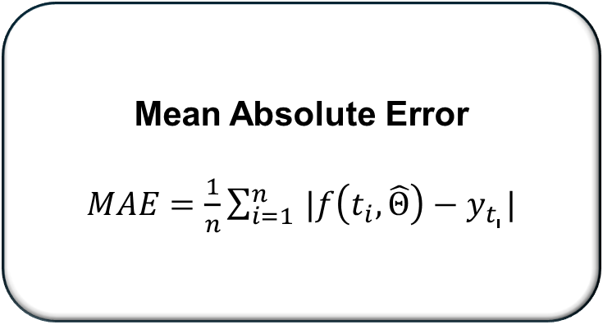
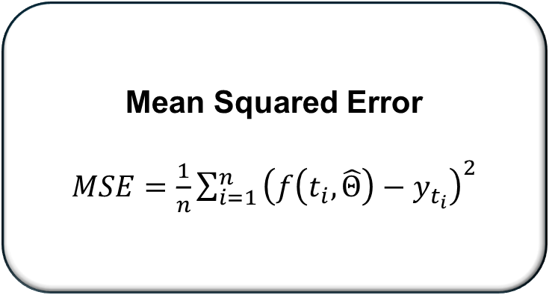
Performance Metrics: Assessing mean trajectory compared to observed data
Mean Absolute Error
$MAE=\frac{1}{n}\sum_{i=1 }^{n}{|f\left(t_{i}, \hat{Θ}\right)−y_{t_{i}}|}$
Mean Squared Error
$MSE=\frac{1}{n}\sum_{i=1 }^{n}{{\left(f\left(t_{i}, \hat{Θ}\right)−y_{t_{i}}\right)}^{2}}$
Notes:
MAE- Distance between the model and the data
MSE= square of difference between the model and the data
MIS and PI account for uncertainty of the prediction
MAE and MSE- assess the closeness of mean trajectory of epidemic to the observed data
MIS- addresses the width of PI and its coverage- employ information about the uncertainty of the model fit

Slide 17
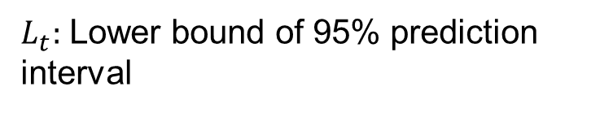
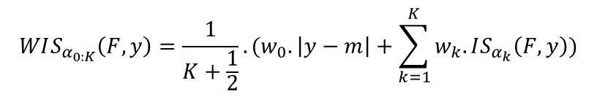
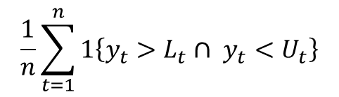
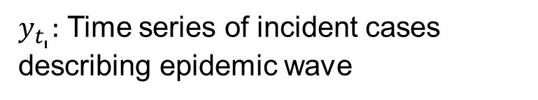
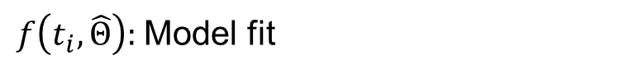
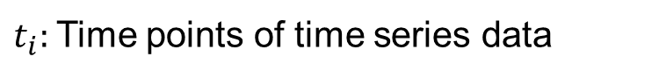
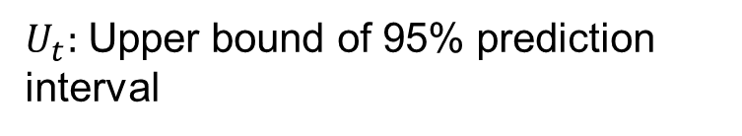
Performance Metrics: Assessing model fit uncertainty
Weighted Interval Score
Weighted Interval Score
Weighted Interval Score
95% Prediction Interval Coverage
$$WIS_{α_{0:K}}\left(F,y\right)=\frac{1}{K+\frac{1}{2}}.(w_{0}.\left|y−m\right|+\sum_{k=1}^{K}{w_{k}.IS_{α_{k}}\left(F,y\right)})$$
$$\frac{1}{n}\sum_{t=1}^{n}{1\left\{y_{t}>L_{t}∩ y_{t}<U_{t}\right\}}$$
$y_{t_{i}}:$ Time series of incident cases describing epidemic wave
$L_{t}:$ Lower bound of 95% prediction interval
$t_{i}:$ Time points of time series data
$U_{t}:$ Upper bound of 95% prediction interval
$f\left(t_{i},\hat{Θ}\right):$ Model fit
Tilmann Gneiting & Adrian E Raftery (2007)
Notes:
MAE- Distance between the model and the data
MSE= square of difference between the model and the data
MIS and PI account for uncertainty of the prediction
MAE and MSE- assess the closeness of mean trajectory of epidemic to the observed data
MIS- addresses the width of PI and its coverage- employ information about the uncertainty of the model fit

Slide 18
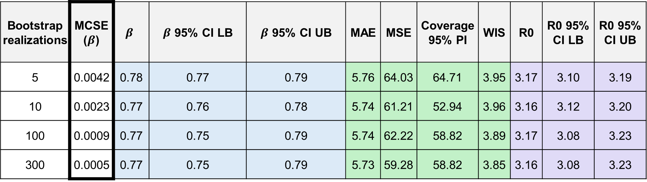
Monte Carlo Standard Errors (MCSEs)
Bootstrap realizations | MCSE ($β$) | $$β$$ | $β$ 95% CI LB | $β$ 95% CI UB | MAE | MSE | Coverage 95% PI | WIS | R0 | R0 95% CI LB | R0 95% CI UB
5 | 0.0042 | 0.78 | 0.77 | 0.79 | 5.76 | 64.03 | 64.71 | 3.95 | 3.17 | 3.10 | 3.19
10 | 0.0023 | 0.77 | 0.76 | 0.78 | 5.74 | 61.21 | 52.94 | 3.96 | 3.16 | 3.12 | 3.20
100 | 0.0009 | 0.77 | 0.75 | 0.79 | 5.74 | 62.22 | 58.82 | 3.89 | 3.17 | 3.08 | 3.23
300 | 0.0005 | 0.77 | 0.75 | 0.79 | 5.73 | 59.28 | 58.82 | 3.85 | 3.16 | 3.08 | 3.23
Measures variability of simulation estimates.
Involves Monte Carlo mean and standard deviation.
Smaller values indicate higher precision.
Balance between computational cost and desired precision.

